Slide 1
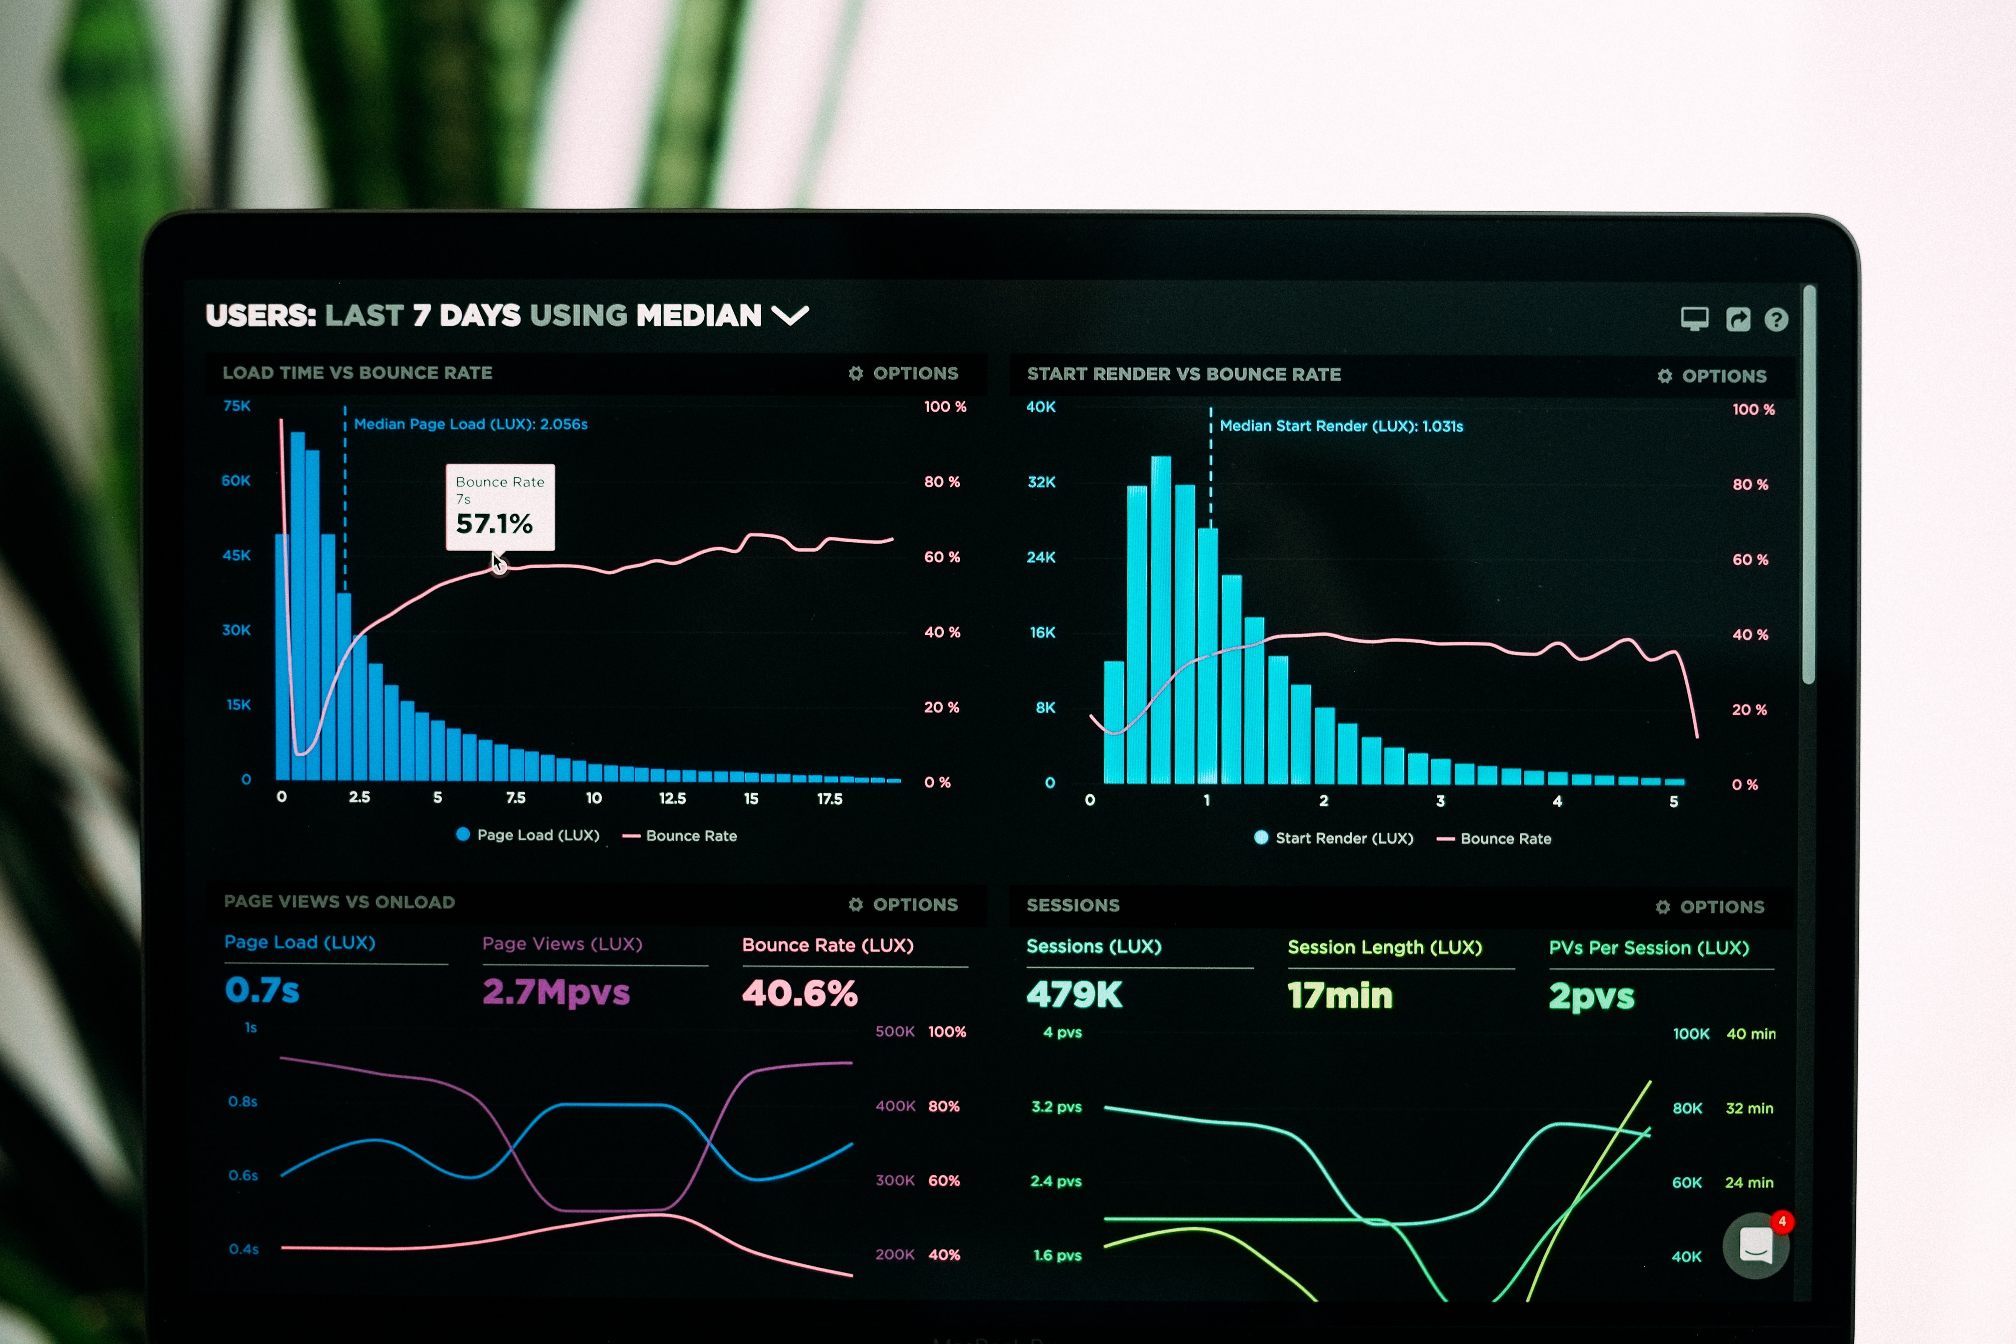
Inter Hall Data Analytics
Team 12

Slide 2

INTRODUCTION
These meters display the energy used on an LCD or LED display, and some can also transmit readings to remote place
1
Electronic Meters
TYPES OF ELECTRIC METERS
The electromechanical induction meter operates by counting the revolutions of a non-magnetic, but electrically conductive, metal disc
2
Electro Mechanical Type

Slide 3
High Level Architecture
TIME SERIES MODELING USING ARIMA & SARIMA
SMOOTHENING SEASONALITY & NORMALISATION
DATA VISUALISATION
TIME SERIES AND REGRESSION MODEL
COMPARING PREDICTION ON VALIDATION
FINAL MODEL AND RESULT ON TEST DATA
DATA PRE-PROCESSING
FEATURE GENERATION BASED ON PREVIOUS LAG
MODEL BUILDING & HYPER-PARAMETER TUNING

Slide 4
Exploratory Data Analysis

Slide 5
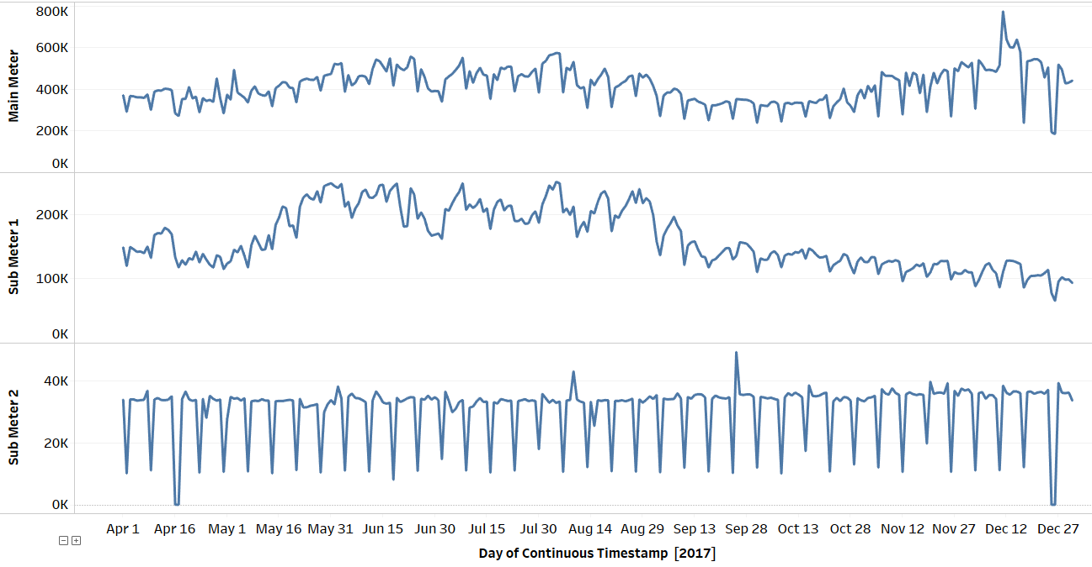
Data Wise Meter Reading Analysis – B1
CONCLUSION
For both the sub meters and main meter reading fall on Sundays and national holidays

Slide 6
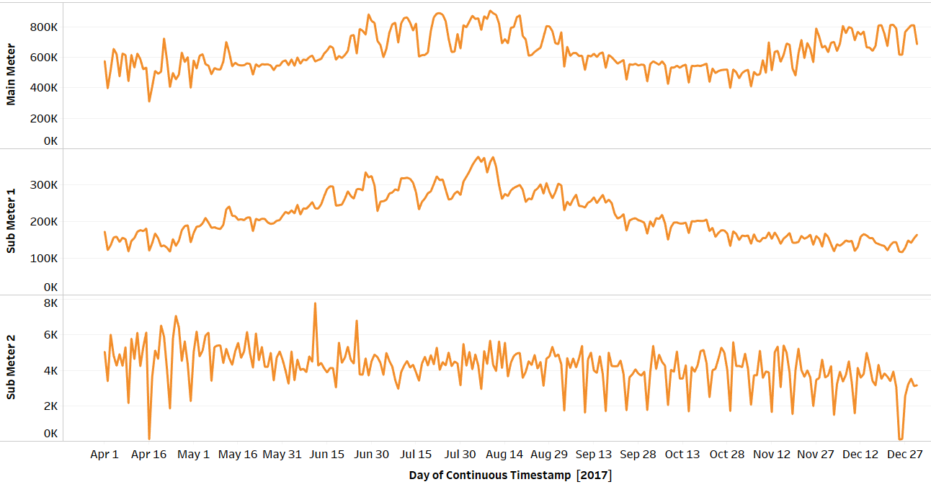
Data Wise Meter Reading Analysis – B2
Building 2 does not show a subtle decrease in reading on Sundays from May to August, however the trend is same September onwards

Slide 7
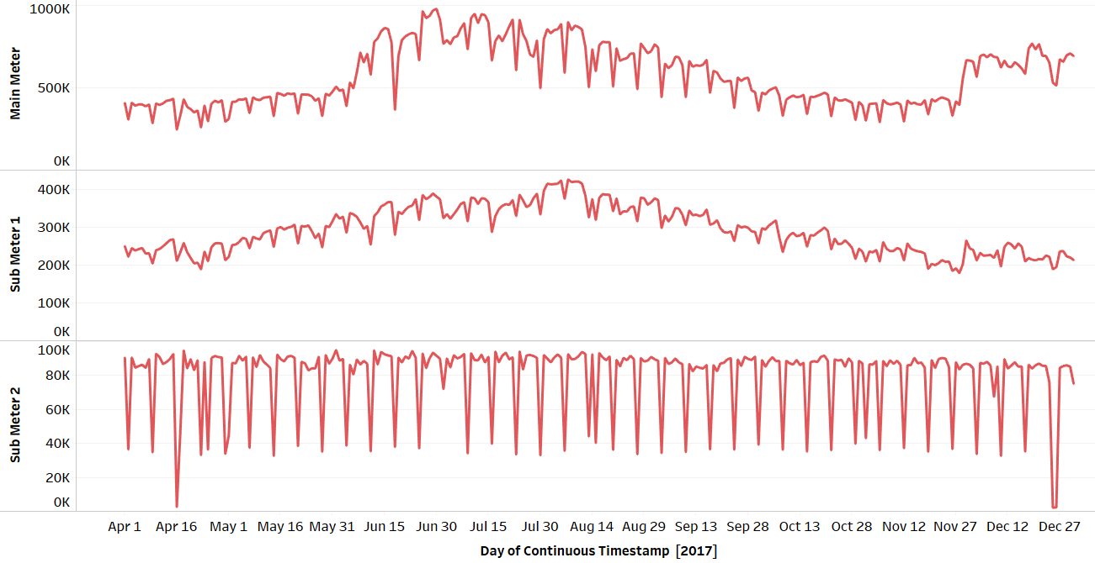
Data Wise Meter Reading Analysis – B3
Similar to building 1, for building 3 and 5 both the sub meters and main meter readings fall on Sundays and national holidays

Slide 8
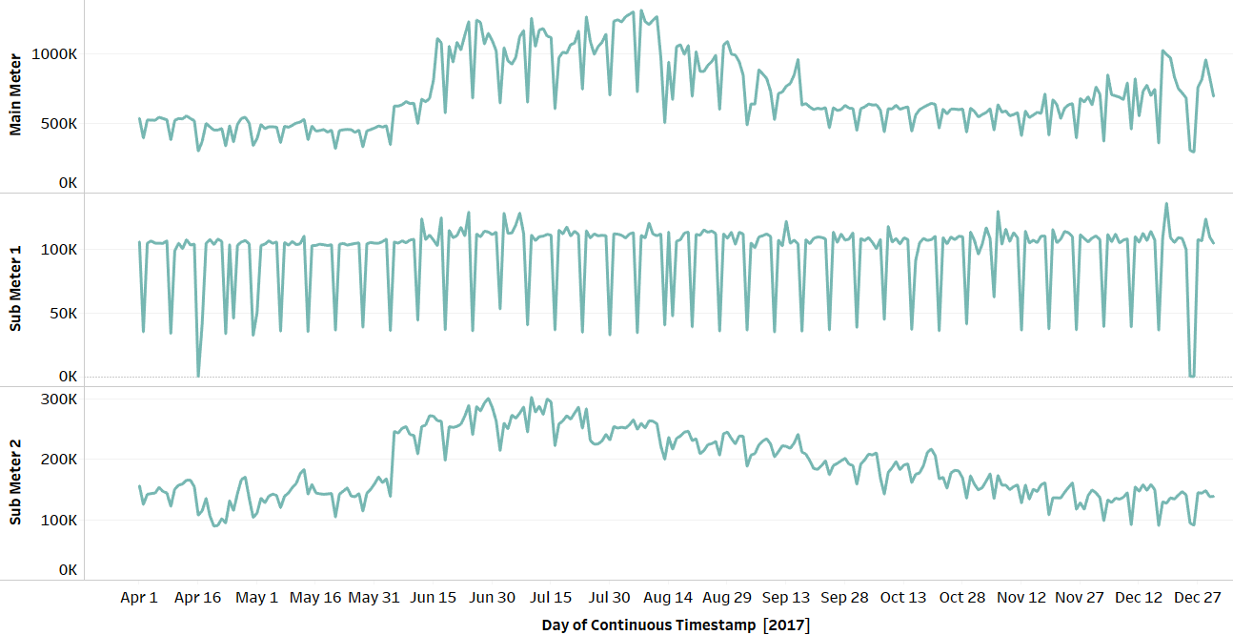
Data Wise Meter Reading Analysis – B4
Although the main meter readings are similar to Building 1, surprisingly the readings for sub meter 1 and sub meter 2 seems to be exchanged

Slide 9
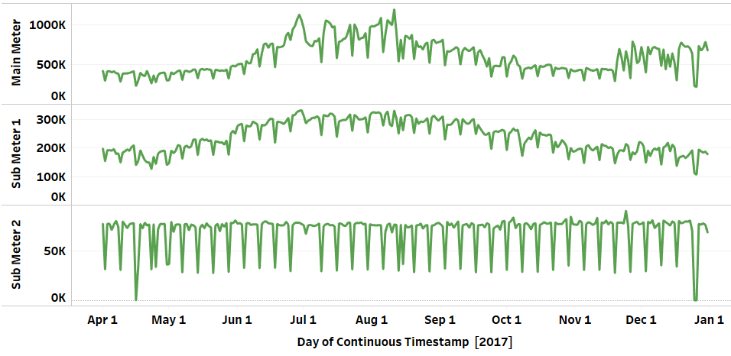
Data Wise Meter Reading Analysis – B5
The main meter readings of Building 5 were found to be similar to Building 3

Slide 10
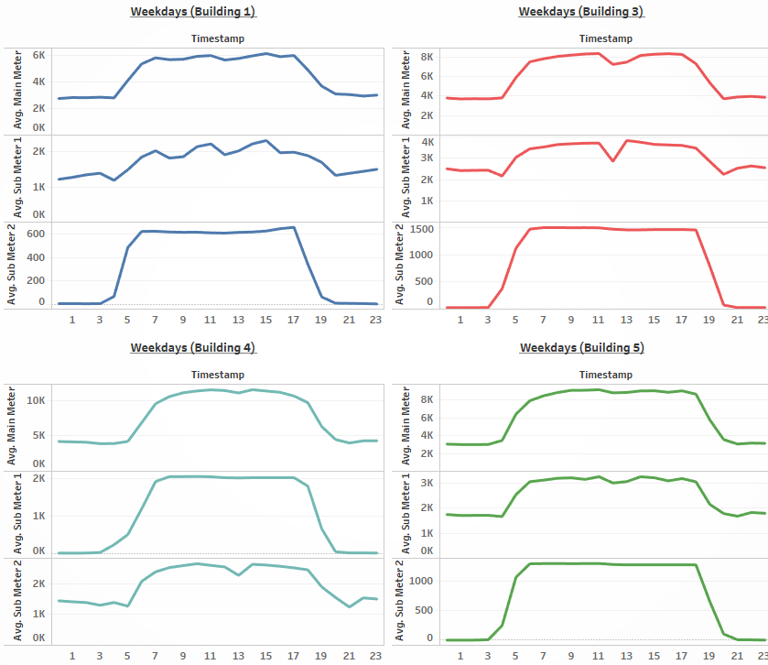
Meter Reading vs Hour of non-Sundays
Our Conclusion
This figure shows the distribution of meter readings against hour of day for all weekdays except Sundays excluding Building 2. We observed a cuspate rise in reading around 4-5 am. However, readings remain more or less constant till 6pm in the evening. A splintery decline from 6 to 8 pm is observed posterior to that the readings continues to remain constant at a lower value

Slide 11
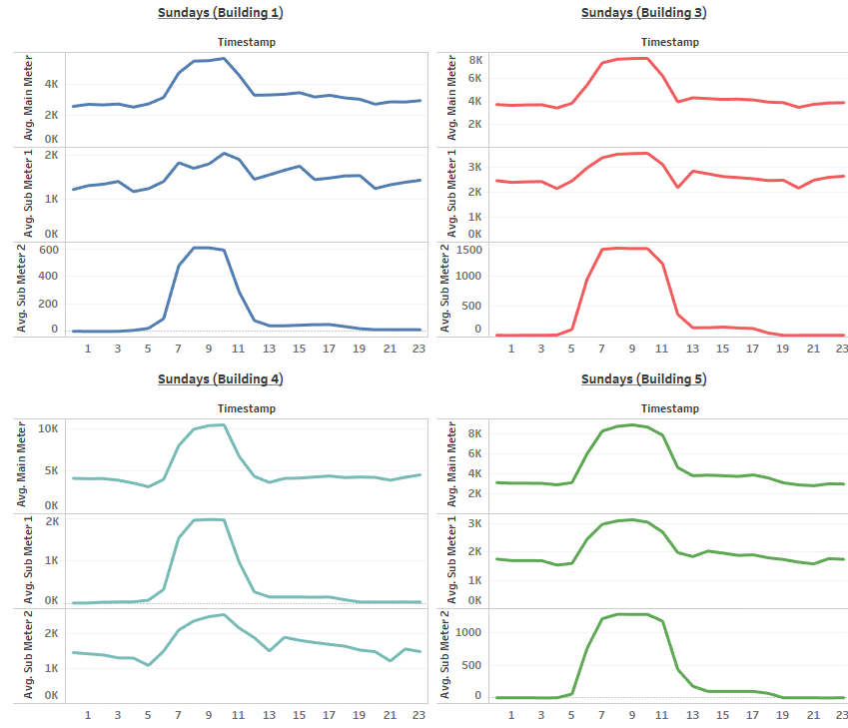
Meter Readings vs Hour of Sundays
Our Conclusion
The distribution of meter readings against hour of day for Sundays excluding Building 2. We observed a rise in reading from 4 am to 6am, remain constant for some time and then fall for the period of 11am to 1 pm, remain constant afterward.

Slide 12
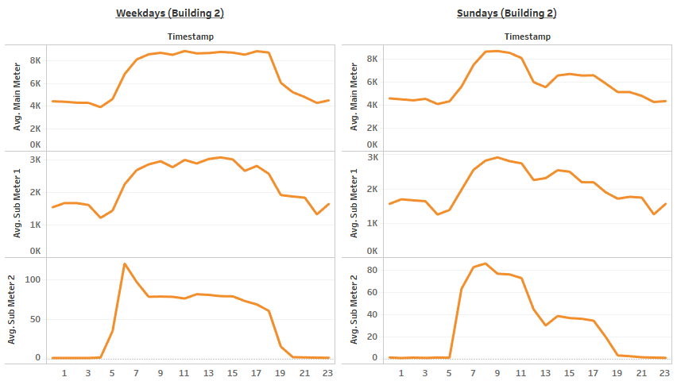
Meter Readings vs Hour of Day
Our Conclusion
In case of Building 2, during weekdays the main-meter and sub-meter 1 show a similar trend like the rest of buildings but is different for sub-meter 2. And during Sundays, all the meter readings differ from other buildings.

Slide 13
Data Preprocessing

Slide 14
Data Preprocessing
Holiday Mapping
Odd Hour Identification
Window Calculation for Working Hours
Noise Removal

Slide 15
Holiday Mapping
National Holidays
Apart from the general seasonality observed during weekdays, different behavior of consumption with hours of day was observed for national holidays.
Algorithm
Calendar Mapping
Anomaly Exclusion
There were some other anomalies which can’t be explained by national holiday. Hence we consider them company specific anomalies.
Company Specific Breaks
⁴ Please refer to the Exhibit for the complete mathematical model

Slide 16

Odd Hour Identification
Algorithm for identification and preprocessing of discrepancies
Identified Start time and End Time of office hours from the meter data.
Calculated two sigma bound on office hours to identify company specific breaks as discussed above
Imputed these identified discrepancies by average of similar days

Slide 17
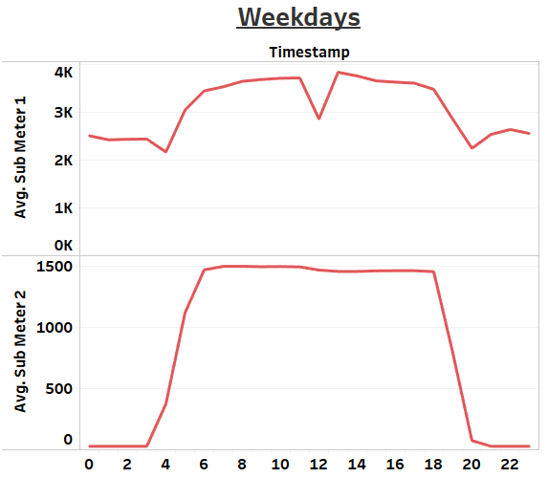
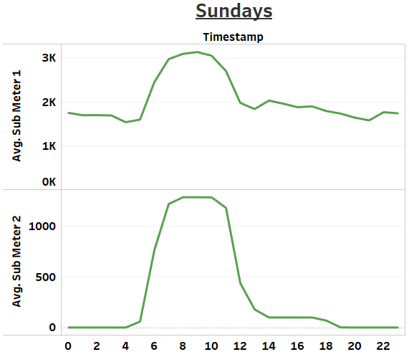
Window Calculation for Working Hours
For buildings 1, 3 and 5
for weekdays, sub meter 1 and main meter depicted a dip during working hours.
The start and end time of the window were found out month-wise for each of the above buildings using the sub meter 2 readings. For building 2, above trends were not found, and thus these steps were avoided. For LSTM model, time windows excluding the above found, were reduced to 1hr time lag to reduce the number of data points.

Slide 18
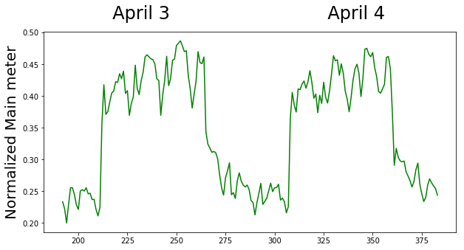
Noise Removal
In order to reduce noise, double exponential smoothening was applied to the data and the time windows found were excluded to avoid normalizing them. This was beneficial in smoothening data to avoid sudden jump in data outside of the mentioned windows.

Slide 19
Feature Engineering

Slide 20
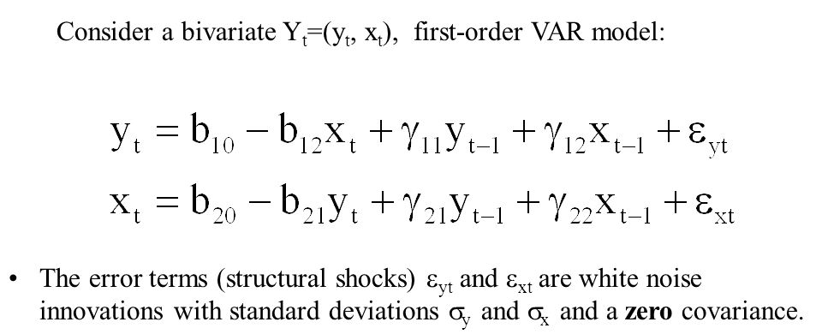
VAR Model to Identify Lags
Structural VAR Model
We experimented with different order VAR to identify interdependence among different meter reading for each building at different lags. Lags 1, 2 and 671 turned out to be most significant.
Example 1st Order VAR

Slide 21
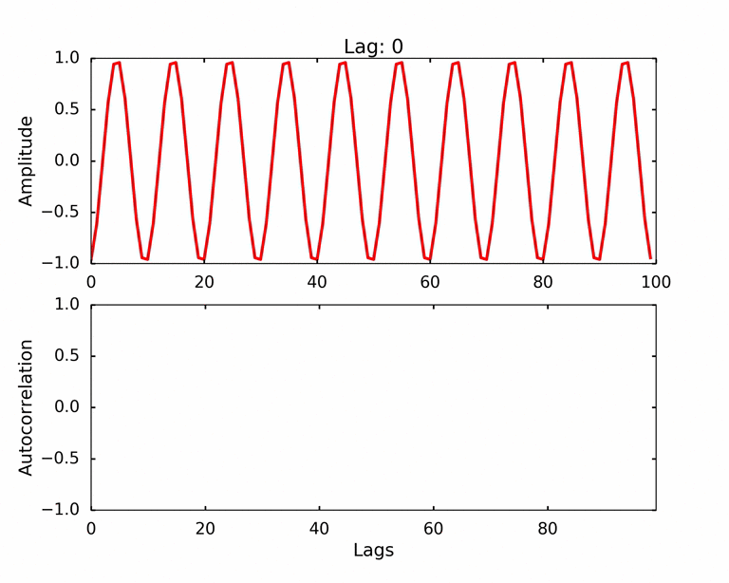
ACF Shuffling to Identify Periodicity
Cyclicity Detection
Example Of ACF
Shuffle the time series 100 times to obtain 100 random samples in the set
Take the 2nd highest peak in the ACF among all the peak powers from these 100 samples
The resulting value will be the 99th percent confidence value for significance thresholding

Slide 22
Models Used

Slide 23
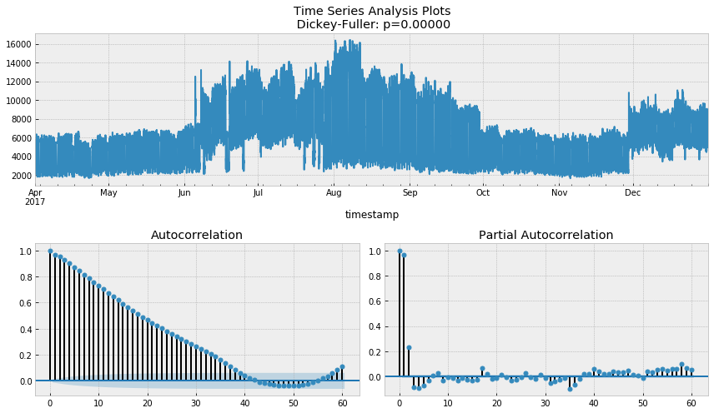
ARIMA
Example For Building 3 Main Meter
First order differencing is done for all three meter readings, further ARIMA time series model is applied to it.
The number of autoregressive terms (p) and the number of lagged forecast errors in the prediction equation (q) are found using the ACF and PACF curves respectively

Slide 24

Regression Model
Timestamp is further divided to create new features namely Month, Day of Month, Day of Week, Day of Year, Ordinal Attributes, Hour of Day and Minute of Day, Is_sunday
Lags features(using VAR) and main meter exhibited high correlations with sub meter 1 and sub meter 2
The new features thus added are normalized using robust StandardScaler
Lasso
1
Ridge
2
XG Boost
3

Slide 25
Results

Slide 26
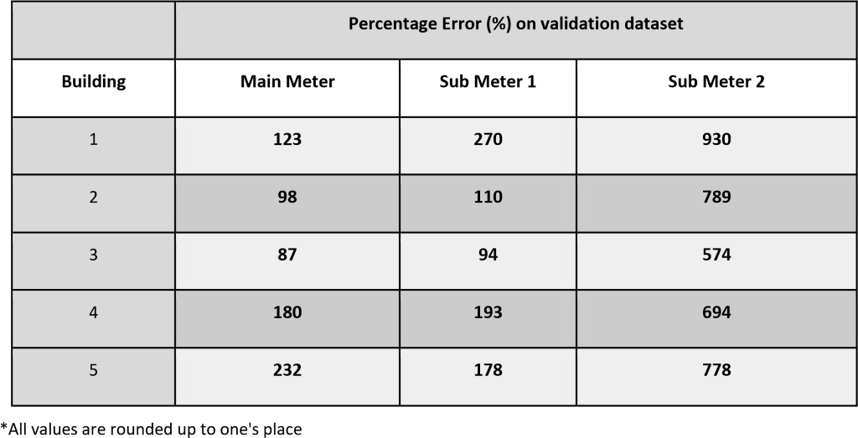
Results For ARIMA

Slide 27
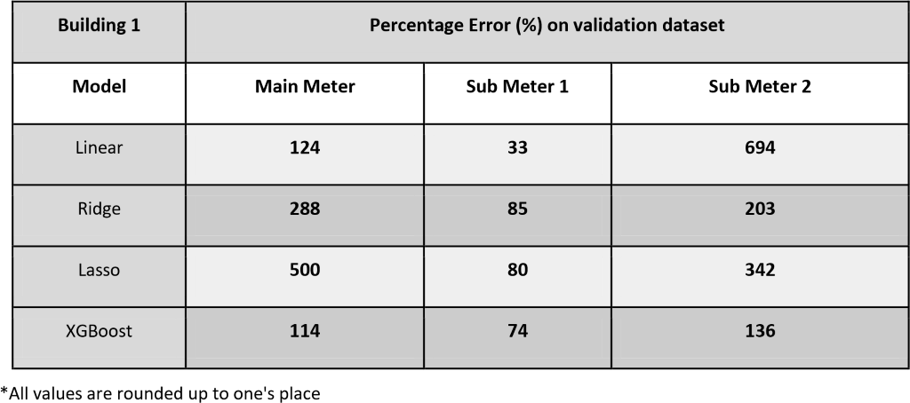
Regression Models

Slide 28
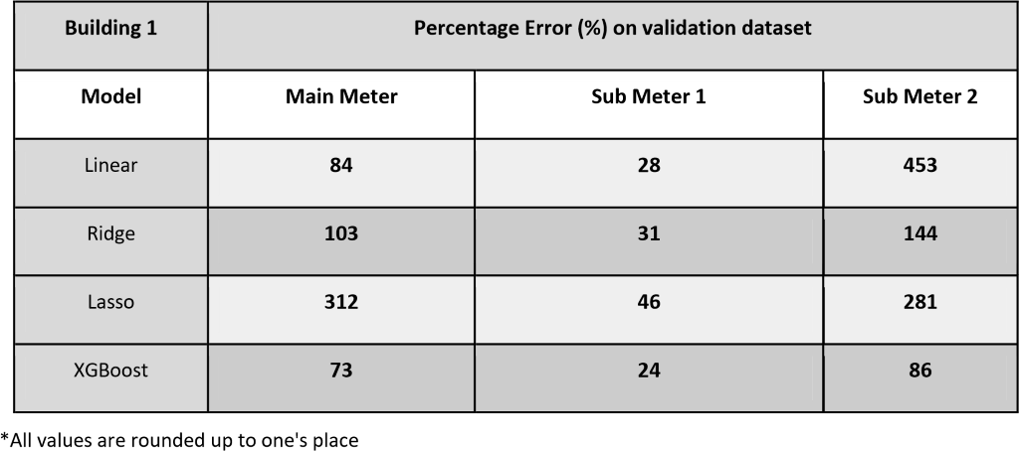
Regression Models With Feature Importance

Slide 29
Final Results
 | Percentage Error (%) on Validation dataset
Building | Main Meter | Sub Meter 1 | Sub Meter 2
1 | 73 (XGBoost) | 23 (XGBoost) | 86 (XGBoost)
2 | 4.8 (Ridge) | 10 (Ridge) | 173 (XGBoost)
3 | 6.2 (XGBoost) | 6.4 (XGBoost) | 74 (XGBoost)
4 | 99 (XGBoost) | 83 (XGBoost) | 95 (XGBoost)
5 | 102 (XGBoost) | 74 (XGBoost) | 203 (Ridge)

Slide 30
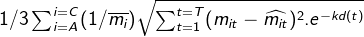
Weighted MSE On Cross Validation Set
Buildings | Score
Building 1 | 9.891
Building 2 | 20.278
Building 3 | 9.240
Building 4 | 10.894
Building 5 | 9.565

Slide 31


Overfitting and Cross Validation
Validation data-set was designed keeping in mind the data distribution. Using periodicity of two months, first 1 and ½ months were used for training purpose and rest ½ month was used for validation purpose and then average results were reported
Cross Validation and Testing
Hyperparameter-tuning was done using Grid Search and validation loss was monitored to avoid overfitting

Slide 32
Thank You

Slide 33
Annexure

Slide 34
Annexure : ARIMA and XGBoost
ARIMA
XGBoost
ARIMA, stands for ‘Auto Regressive Integrated Moving Average’ is actually a class of models which ‘explains’ a given time series based on its own past values, that is, its own lags and the lagged forecast errors, so that equation can be used to forecast future values.
XGBoost is short for eXtreme Gradient Boosting. It is a library designed and optimized for boosted tree algorithms. Its main goal is to push the extreme of the computational limits of machines to provide a scalable, portable and accurate for large scale tree boosting.

Slide 35
Annexure: Feature Importance
Feature​ | Relative Importance​
Lag_1​ | 0.018226​
Sub_meter_1_pred​ | 0.016145​
Weekday​ | 0.014615​
Lag_2​ | 0.014382​
Lag_671​ | 0.013301​
Lag_288​ | 0.012091​
Lag_286​ | 0.012024​
Time_sine​ | 0.011096​
Lag_190​ | 0.011078​
1

Slide 36
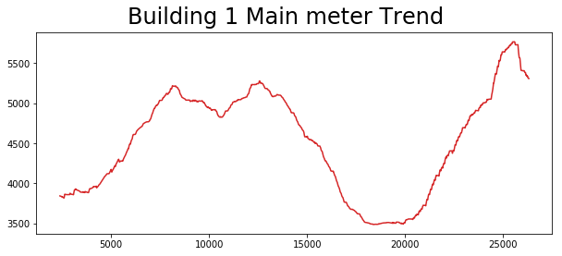
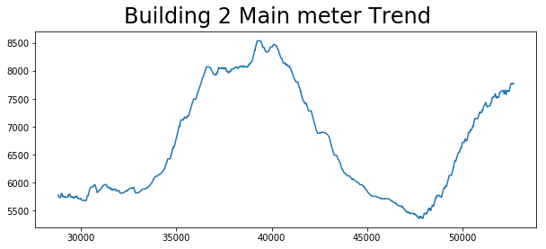
Annexure: Some Other Visualizations

Slide 37
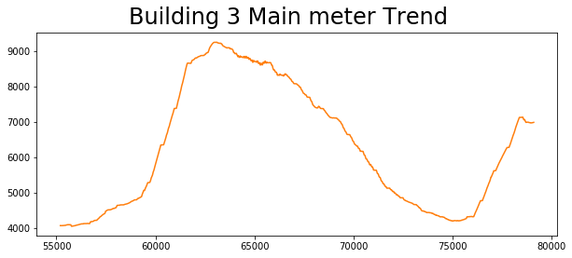
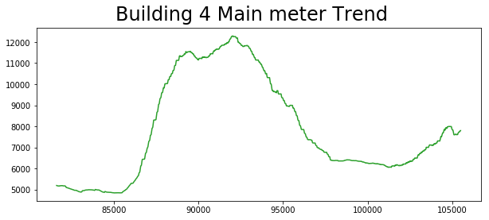
Annexure: Some Other Visualizations

Slide 38
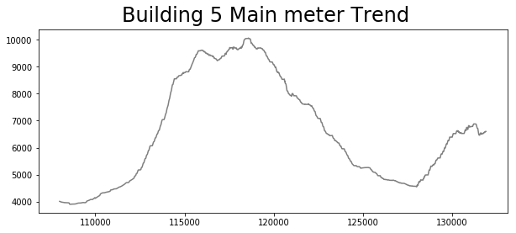
Annexure: Some Other Visualizations

